Slide 1
WORKSHOP ON FACE RECOGNITION USING PRINCIPAL COMPONENT ANALYSIS
By:
Sibi Renganatth

Slide 2
CONTENTS
INTRODUCTION
WHAT IS PCA?
HOW DOES PCA WORK FOR FACE RECOGNITION?
CODE FOR FACE RECOGNITION
INFERENCES AND EFFICIENCY
CONCLUSION

Slide 3
INTRODUCTION
Face Recognition is being implemented in our daily lives as a form of verification and validation.
This also has various applications especially in the field of authentication
As we see, machine learning is a fast growing area and has more opportunities and applications in our daily life activities.
Face recognition using machine learning can be implemented. But, it is necessary to know how pattern recognition actually works , before going on to the complex machine learning algorithms.
This calls for the implementation of face recognition using basic pattern recognition techniques. Ex: Principal Component Analysis, in short, PCA, Independent Component Analysis(ICA), Kernel PCA

Slide 4
WHAT IS PCA?
Principal Component Analysis is a statistical method which makes use of orthogonalization of a given data set having correlations with each other into a set of values which are linearly independent of each other.
This is similar to the analogy of linearly dependent and independent vectors in mathematics.
These linearly independent variables that represent the data set are called principal components and their dimensions will be less than the number of original variables.
The transformation is defined such that the components have the maximum possible variance.
The other components have to be orthogonal to each other.
The components are orthogonal to each other because they are eigenvectors of the covariance matrix of the data set.
The covariance matrix is symmetric in nature.
But what is covariance??
Covariance is a measure of how two variables change together.
So, to find the different features, we make use of covariance. So, we make use of covariance matrix of face space. This is found with the help of the product of the face vector space and its transpose.

Slide 5
HOW DOES PCA WORK FOR FACE RECOGNITION?
A photograph or an image is made of tiny dots or squares called pixels. The pixels contain the information about the image.
Basically, any color image has three components R,G and B - the primary colours (red, green and blue)
The pixels contain the amount or the intensity of the colour present.
The values of each colour ranges from 0-255, with 0 being the least intensity and 255 being the highest.
So, the pixels can be considered as a row matrix of dimensions 3X1.

Slide 6
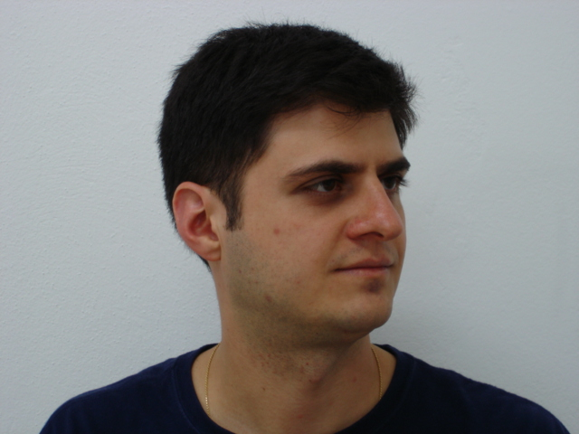
FACE RECOGNITION USING PCA
Every photo has dimensions- width and height.
Example:
The above example has dimensions of 640X480
This means that there are 640 pixels in a row and 480 pixels in a column
Totally there are 307200 pixels in this image, with each pixel having a RGB value.

Slide 7
HOW TO APPLY PCA
In order to apply PCA for face recognition, we need our images of faces in greyscale, i.e., in black and white. This reduces the values contained in the pixel as the pixels will now only contain the intensity of the colour black.
We need a training set of faces of people we need to recognise. Say, we are going to design a face recognition system for 10 students, with two images of each student.
So, we require 10*2=20 face images in our training set.
As we see, an image is a two dimensional array with the entries being the pixel values.
To apply PCA, we need to create one dimensional arrays or vectors of faces. We are using images of size 281X381 pixels.
While resizing the images, we get a set of 20 one dimensional face vectors of size 107061X1

Slide 8
The first step of face recognition using PCA is to normalize the given set of face vectors.
The mean of the face vectors is found and the mean is subtracted or removed from each face vector, thereby giving a new set of face vector with each vector having dissimilar components.
The average face vector actually means the collection of average components or features of the entire face vector set.
So, what we are doing here is we try to get the features that are different for different faces.
Now, we have a face space of dimensions 107061*20
The PCA algorithm works on the decomposition of co-variance matrix.
If we consider our face vector space as A, then the covariance matrix of A is given by
C= A*transpose(A)
where transpose of A is used.

Slide 9
This covariance matrix will be of dimension 107061*20 * 20*107061 = 107061*107061.
So, the covariance matrix, C will generate 107061 eigenvectors, called eigenfaces, each of dimension 107061*1
The PCA plays an important role here.
The PCA selects k eigenfaces that best represent the faces present in the training set. This k can be less than or equal to the number of persons trained.
If we need to select a k eigenfaces from 107061 eigenfaces, computation problems and lack of memory might occur.
So, we make use of dimensionality reduction.
How do we reduce dimension?

Slide 10
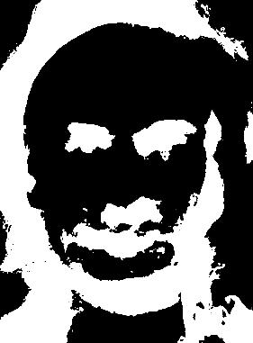
How does an eigenface look like?
What exactly is an eigenface?
Eigen face is nothing but a feature map which consists of all the important features present in one’s face, like eyes, nose, ears, lips, etc.

Slide 11
To reduce calculations, we make use of the lower dimensional subspace of the face vector space.
The covariance matrix, C becomes
C= tr(A)*A
where tr(A) is the transpose of A
Instead of having 107061*107061 entries, we reduce the dimension drastically to 20*107061* 107061*20=20*20
So, the eigen faces will have dimensions 20*1 and also the number of eigen faces to be chosen will be less than or equal to 20
Thus it is easier to find k eigenfaces from a lesser eigenface space
Now, we need to find the k best eigenfaces from the 20 eigenfaces.

Slide 12
Now, to recognise faces, we need the eigen faces of lower dimensionality and map them into eigen faces of original dimensionality.
This is achieved by multiplying the k eigen faces with the original face space.
E= A* Eigenface space
Thus, the noise is reduced in the eigenfaces and recognition has much higher performance.
Now, we need to represent each image in the face space as a linear combination of the k eigen faces plus the mean face vector.

Slide 13
So, each face vector has certain components called weights, which actually is the constant multiplied with each eigen face to get the original face vector. It actually tells about the contribution each eigen face gives to the original face vectors.
So, we collect 20 weight vectors, each for the 20 face vectors.
Now, the system is trained.

Slide 14
RECOGNITION
With the system trained, we can use it for face recognition.
Suppose a face image is given as input to the system, the image is translated into a face vector.
Now the face vector is normalised by removing the mean face vector from the face vector.
Now, we have to project the face vector into the Eigenspace, meaning we represent the input face vector as a linear combination of k eigen faces.
With this, we can find the weight vector of the input face.
Now, this weight vector is compared with the 20 weight vectors and the distance between them is calculated.
This distance is now compared with a threshold set during training. If the distance is less than the threshold, then the face is recognised.
If not, the face is not recognised.

Slide 15
TRAINING OF FACES
Conversion of color images into greyscale images
Generating weight vectors for training set faces
Conversion of faces into one dimensional face vectors
Calculation of eigen vectors and choosing k eigen faces
Normalisation of face vectors(Removal of mean faces)
Covariance matrix of face space

Slide 16
TESTING OF FACES
Conversion of colour face image into greyscale image
Classification of face with threshold
Translation of face image into face vector
Calculation of distance between the weight vectors
Normalisation of input face vector
Calculation of weight vector using k eigen faces

Slide 17
CODE FOR FACE RECOGNITION
The code to be executed is named main.m
The entire face recognition process is divided into Training and Testing.
For Training, the following functions are used: TrainSystem, TrainDatabase,Eigenfacecore
For testing, the functions used are: FaceRec, Recognition and saveimage
Also, there are certain changes to be done before executing the code.
The changes will be notified while execution

Slide 18
TASKS
Task-1: Use a 10 person database with 2 images
Result: There are 5 correctly classified images and 5 wrongly classified.
Now, we shall attempt to increase the number of images

Slide 19
Task-2: Implement a 10 person database with 4 images
Result: There is a 70% efficiency when compared to using 2 images per person

Slide 20
Task-3: Implement a 20 person database with 4 images per person
Result: Maximum of 80% is obtained of the three tasks.

Slide 21
CONCLUSION
The efficiency of face recognition using PCA is around 75% for a predefined database FEI.
The efficiency for a real time face recognition system is much more less, around 50-60%
This pushes the need for implementing face recognition using deep learning.
We will try to implement it using neural networks, a part of machine learning next .

